Slide 1
16x2 liquid crystal display (LCD)

Slide 2
16x2 LCD DISPLAY
As per the name the 2x16 has 2 lines with 16 chars on each lines
A 16×2 LCD is a very basic module and is very commonly used in various devices and circuits. These modules are preferred over seven segments and other multi-segment LEDs.
The reasons are that LCDs are economical; easily programmable; and have no limitation of displaying special & even custom characters (unlike in seven segments), animations.

Slide 3
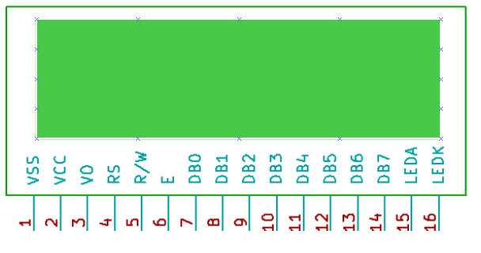
16×2 LCD Pin Out

Slide 4
Pin Number and Functions
Pin Number | Symbol | Pin Function
1 | VSS | Ground
2 | VCC | +5v
3 | VEE | Contrast adjustment (VO)
4 | RS | Register Select. 0:Command, 1: Data
5 | R/W | Read/Write, R/W=0: Write & R/W=1: Read
6 | EN | Enable. Falling edge triggered
7 | D0 | Data Bit 0
8 | D1 | Data Bit 1
9 | D2 | Data Bit 2
10 | D3 | Data Bit 3
11 | D4 | Data Bit 4
12 | D5 | Data Bit 5
13 | D6 | Data Bit 6
14 | D7 | Data Bit 7/Busy Flag
15 | A/LED+ | Back-light Anode(+)
16 | K/LED- | Back-Light Cathode(-)

Slide 5
LCD has two registers, namely, Command and Data.
The command register stores the command instructions given to the LCD. A command is an instruction given to LCD to do a predefined task like initializing it, clearing its screen, setting the cursor position, controlling the display, etc.
The data register stores the data to be displayed on the LCD. The data is the ASCII value of the character to be displayed on the LCD.
Data Bus: As shown in the above figure and table, an alpha numeric lcd has a 8-bit data bus referenced as D0-D7.
The LCD module requires 3 control lines, which are referred to as EN, RS, and RW.

Slide 6
Register Select(RS): Any data that needs to be displayed on the LCD has to be written to the data register of LCD. Command can be issued to LCD by writing it to Command register of LCD. This signal is used to differentiate the data/cmd received by the LCD.
If the RS signal is LOW then the LCD interprets the 8-bit info as Command and writes it Command register and performs the action as per the command.
If the RS signal is HIGH then the LCD interprets the 8-bit info as data and copies it to data register. After that the LCD decodes the data for generating the 5x7 pattern and finally displays on the LCD.

Slide 7
Read/Write(RW): This signal is used to write the data/cmd to LCD and reads the busy flag of LCD. For write operation the RW should be LOW and for read operation the R/W should be HIGH.
Enable(EN): This pin is used to send the enable trigger to LCD. After sending the data/cmd, Selecting the data/cmd register, Selecting the Write operation. A HIGH-to-LOW pulse has to be send on this enable pin which will latch the info into the LCD register and triggers the LCD to act accordingly.

Slide 8
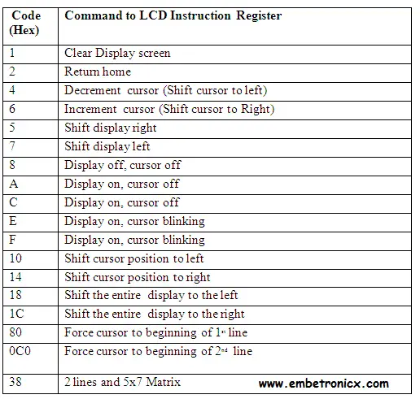
LCD COMMANDS

Slide 9
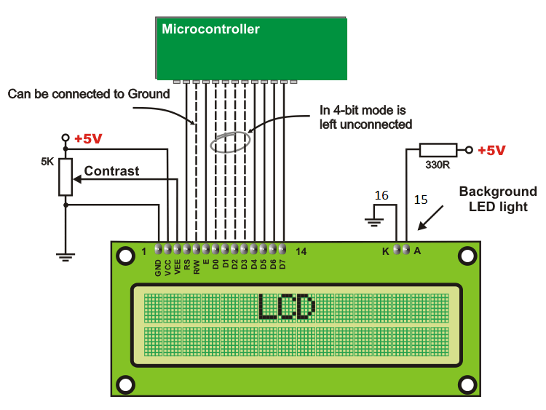

Slide 10
To program a 16x2 LCD display with a microcontroller, you can follow these steps:
Initialize the LCD.
Send commands to the LCD.
Write data to the LCD.

Slide 11
Sending Data/Command to the LCD
Make R/W low.
Make RS=1, if the data byte is a data to be displayed and make. (Select Data Register)
RS=0, if the data byte is a command. (Select Command Register)
Place data byte on the data register.
Send a High-to-Low pulse on EN PIN with some delay_us
Repeat the above steps for sending other data.

Slide 12
Steps for Sending Command:
step1: Send the I/P command to LCD.
step2: Select the Control Register by making RS low.
step3: Select Write operation making RW low.
step4: Send a High-to-Low pulse on Enable PIN with some delay_us.
Steps for Sending Data:
step1: Send the character to LCD.
step2: Select the Data Register by making RS high.
step3: Select Write operation making RW low.
step4: Send a High-to-Low pulse on Enable PIN with some delay_us.

Slide 13
#include<pic.h>
#define rs RC0
#define rw RC1
#define en RC2
#define delay for(j=0;j<1000;j++)
int j;
void lcd_init();
void cmd(unsigned char a);
void dat(unsigned char b);
void show(unsigned char *s);

Slide 14
void main()
{ unsigned int i;
TRISB=TRISC0=TRISC1=TRISC2=0;
lcd_init();
cmd(0x8A); //forcing the cursor at 0x8A position
show("WELCOME TO ________");
while(1) {
for(i=0;i<15000;i++);
cmd(0x18);
for(i=0;i<15000;i++); } }

Slide 15
void lcd_init()
{ cmd(0x38);
cmd(0x0c);
cmd(0x06);
cmd(0x80);
}
void cmd(unsigned char a)
{ PORTB=a;
rs=0;
rw=0;
en=1;
delay;
en=0;
}

Slide 16
void dat(unsigned char b)
{
PORTB=b;
rs=1;
rw=0;
en=1;
delay;
en=0;
}
void show(unsigned char *s)
{
while(*s) {
dat(*s++);
}
}

Slide 17
